Slide 1
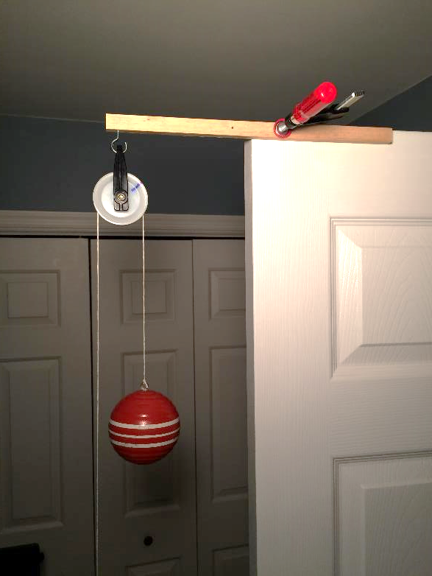
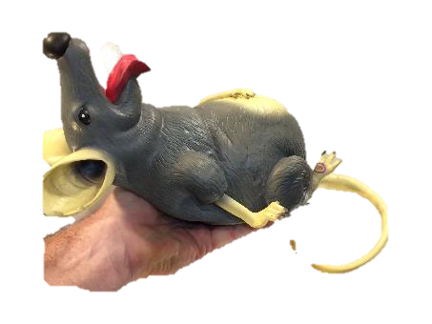
Work and Energy
Potential Energy
Build a Pulley Test Rig
LabRat Scientific
© 2018

Slide 2
LabRat experiments often require the use of a simple pulley system that accommodates long travel. The experiments may also rely on using a smart phone as a timing device. This presentation provides some suggestions for making a pulley test rig.

Slide 3
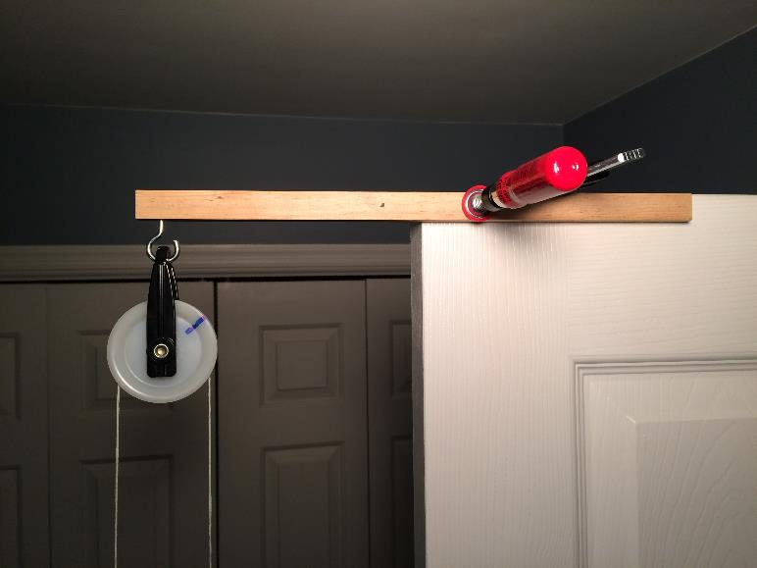
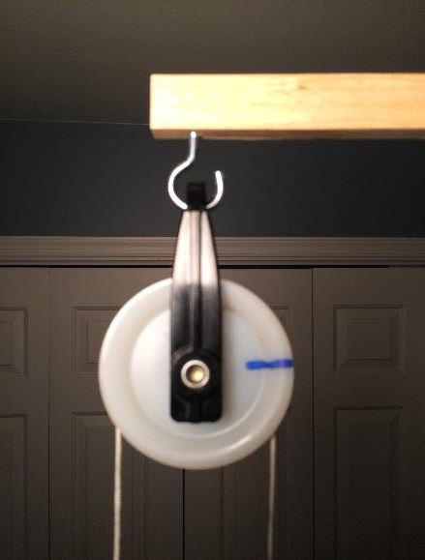
Pulley and Mounting Beam
Pulley is attached using eye hook. Use pliers to open up the hook. Pulley obtained from home improvement store.
Simple wood support beam clamped to door. Wood is square trim molding obtained from home improvement store.

Slide 4
Pulley Marking
The pulley is marked with a prominent line so that rotations can be counted on the experiment video.
Smart phone video is recorded at 30 frames/sec. Image smear limits how fast the event can be. If the pulley spins too fast, the reference mark will appear as a smear on the video image and determining precise timing will be difficult.

Slide 5
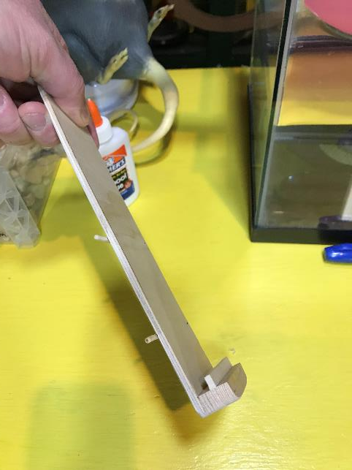
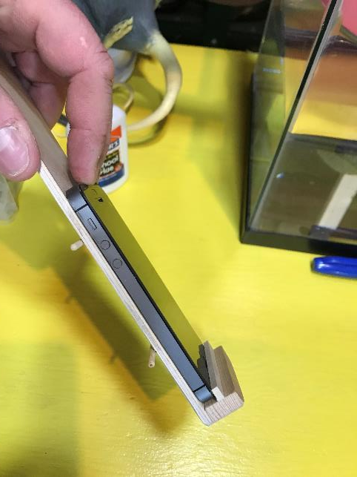
Simple Smart Phone Holder
Scrap wood was used to build this simple Smart Phone holder. It can be clamed to various test rigs as required.
The phone is captured at the bottom and held in place at the top by a rubber band.

Slide 6
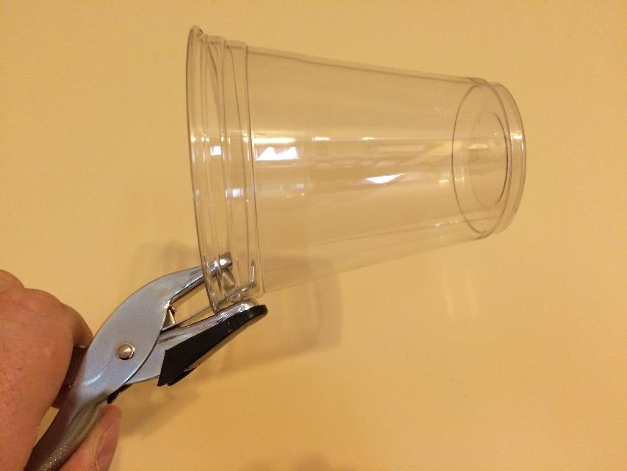
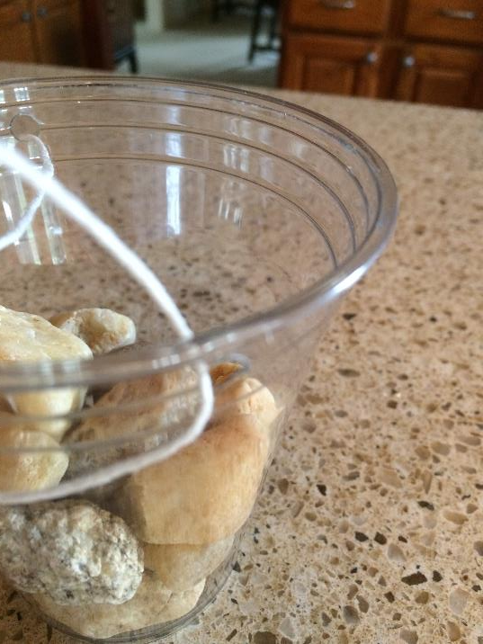
Simple Weight Cup
Use a hole punch to make a sting hole near the top of the cup. Make a 2nd hole 180 degrees from the first.
Pass a string through each hole and tie the ends.

Slide 7
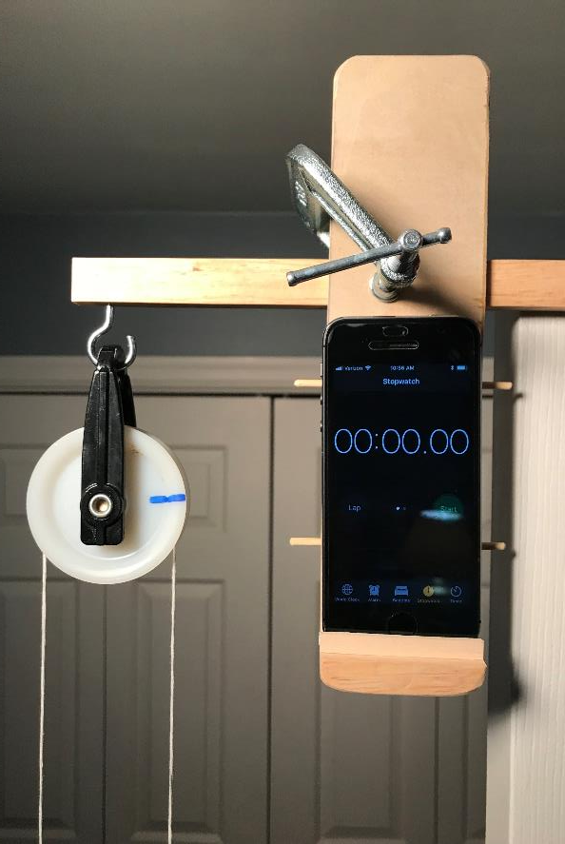
The rig can be mounted in many different ways. Here the complete rig is mounted to a door using a C-clamp.
Smart Phone Holder

Slide 8
The distance an object moves can be determined:
Distance = Revolutions * Circumference
The blue mark on the pulley wheel serves as a reference to count revolutions.
By using the smart phone stopwatch function, velocity can be determined:
Distance
Velocity = --------------
Time
Tests are recorded using a web camera (or other smart phone) and the video can be replayed in slow motion to extract the data.
Smart Phone Holder

